Slide 1
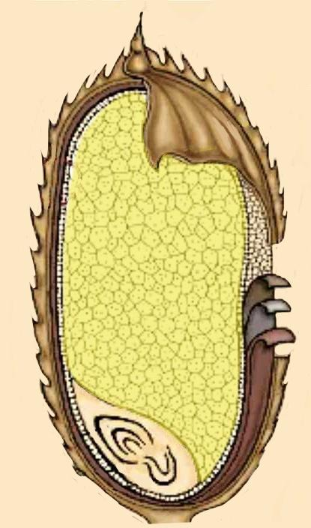
Paco Chan, 82033788
Nucha Powanusorn, 51000289
Soseki Kashimori, 85121903
Golden Rice – Summary
Identify enzymes
(proteins) of interest
Incubate Agrobacterium
with Germ
(rice embryos)
Screen for marked cells
Grow up modified plants
Identify the genes that
encode for enzymes
Ti-Plasmid attaches to
plant cell and inserts
T-DNA which may become
stably incorporated into the
cell’s nuclear genome
Plants flower
Insert the genes into the
T-DNA region of the
Ti-Plasmid in Agrobacterium
Pollination
Plants produce Fruit
Enzymes in endosperm cells
Cytoplasm of
endosperm cells
Within nucleus of
endosperm cells
produce
Translation:
Process of ribosomes producing proteins from mRNA
Transcription:
The process where DNA is converted into RNA
mRNA
β-carotene
Consumed by
humans
β-carotene converted to Vitamin A
Proteins (enzymes)
mRNA

